Slide 1
Genetic Algorithms – What They Are, How to Apply Them to Solve Problems, and How to Create Your Own St. Louis Machine Learning & Data Science Genome Lab - September 17, 2014
David L. Snell, ASA, MAAA, FLMI, CLU, ChFC, ARA, ACS, MCP
technology evangelist, RGA Reinsurance Company

Slide 2
A Genetic Algorithm can be useful for …
Provider group selection
Sales representatives and regions
ERM … beyond CTE
Stress tests when valuing a block of business
Traveling Salesperson
Non-linear equations

Slide 3
Why do we call these Genetic Algorithms?
Genetic Algorithms
They mimic our current knowledge of genetics.
We have trillions of cells.
DNA represents a blueprint for a cell.
It is used to generate copies.
The actual process involves proteins and lots of other biological terms …
and you don’t have to know them to solve problems!

Slide 4
Yet another version of the Traveling Salesperson problem … with a few twists:
Distances vary between cities
Some cities are worth more than others to visit
We don’t want to exceed 1,000 miles
There is a mileage penalty in the scoring algorithm
You can visit a city more than once (but for less credit)

Slide 5
Let’s see a real world actuarial example:
Health Provider Network
500 potential providers for this example
Each provider offers up to 36 specialties
Each specialty has a relative cost
Each Provider has a relative cost
You have to provide a sufficient number of practitioners for each of the specialty choices
You want to minimize overall cost
More than 10 to the 150th possible solution sets

Slide 6
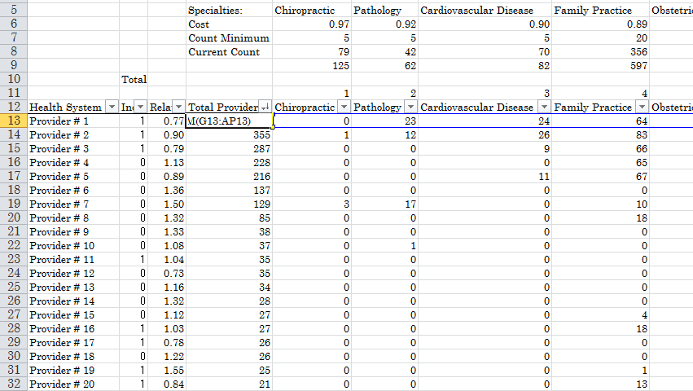
Provider Network Cost Optimization
Each provider group is in (1) or out (0) of network.
Each provider group can have multiple specialists; and has a relative cost.
500 Providers for this example; but could have thousands. Lots of specialties. Could have 2^500 (> 10^150) solution sets … might take a while by traditional methods. ☺

Slide 7
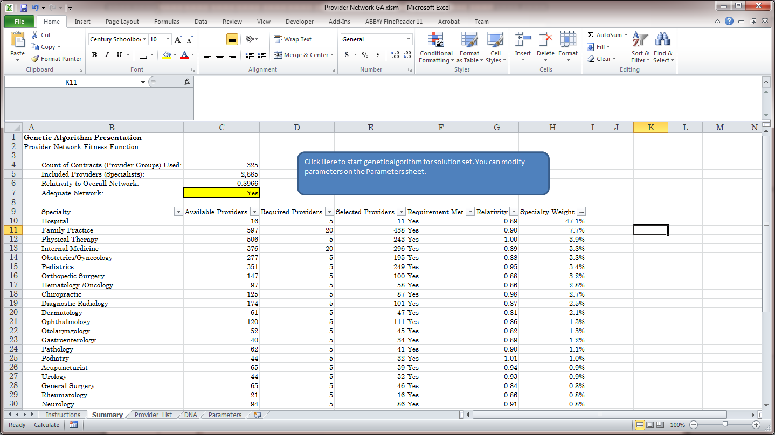
Provider Network Cost Optimization (continued)
Each specialty area must have adequate coverage.

Slide 8
Some problems just don’t fit well into classical methods of solution:
Assume you have three equations:
y₁ = a * e * g + h + dª
y₂ = |h|! - |d|!
y₃ = ((sin(a)) + b) * log(b + c)) + cos(min(c, d)) * (e – f + g * h)
Find a combination of a, b, c, d, e, f, g, h
such that the standard deviation
^{of y}₁^{, y}₂^{, and y}₃ ^{is minimized.}
Oh yeah!
We are math folks, so this might be too easy by itself!
a has to be an integer from 1 to 10
b is a real number from 0 to 15
c is a real number from 1 to 3
d is a real number from 0.5 to 7
e is a real number from -10 to 50
f is an even integer from -20 to 40
g is a real number from 0 to 18
h is a real number from 3 to 12
Let’s add some constraints to make it more interesting!

Slide 9
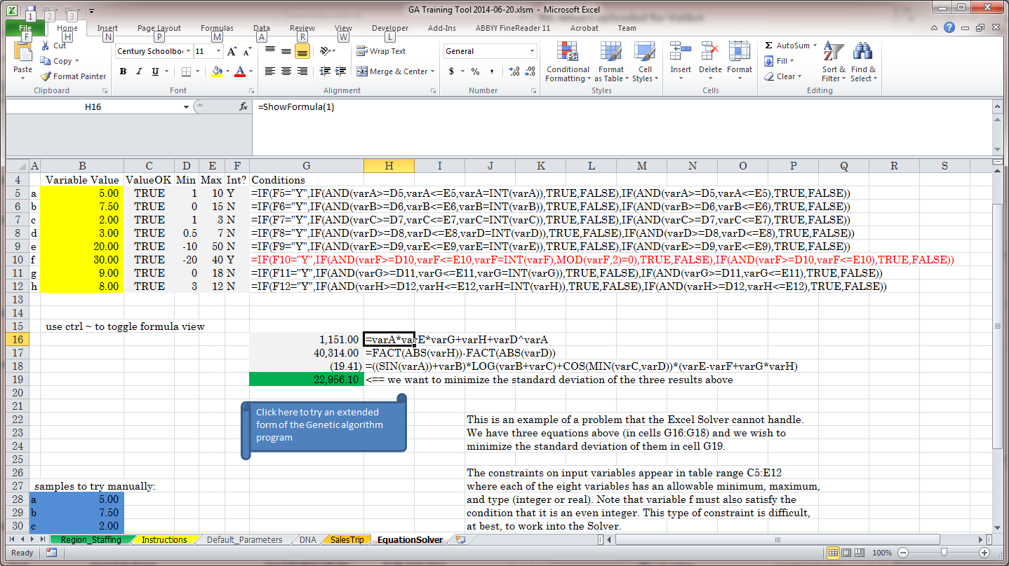
How to attack a really monstrous problem (continued … expressed as an Excel sheet)

Slide 10


Looking Behind the Curtain
Stepping through the code for our examples
Learning to fish evolve

Slide 11
Criteria that make a problem suitable for a genetic algorithm
The problem involves a lot of variables - to some extent, the more variables there are, the better this technique applies.
Each variable can take on potential values to produce different solutions.
We can substitute a value for each of the variables and that particular combination of individual values can be thought of as a solution set.
The problem can be quantified in some manner so that any two solution sets can easily be compared to see which is better.
Mitosis/meiosis
Single nucleotide polymorphisms
Alleles/ phenotypes
Adenine, Cytosine, Thymine, Guanine
OMG
That is so simple!

Slide 12
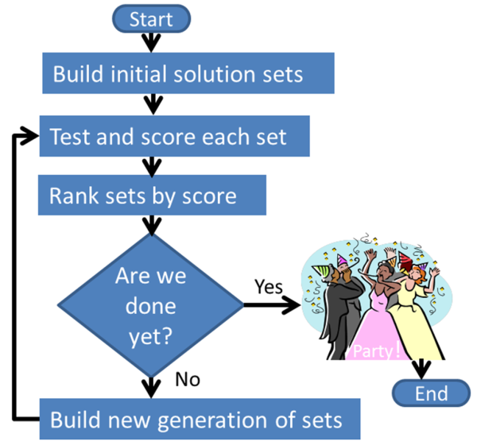
How to build a genetic algorithm

Slide 13
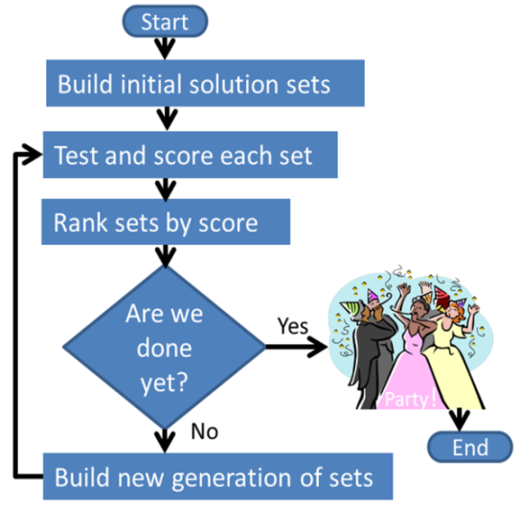
Understanding what is behind the curtain
1. Populate a collection of possible solution sets.
2. Test each set of the collection and save the scores obtained.
3. Rank the scores.
4. Build the successive collection (generation) of solution sets.
5. Repeat steps 2 thru 4 until done.

Slide 14
from elsewhere: elites = 20
setsPerGeneration = 100
parentPool = 40
solutionSets is a
2-dimensional array 30 by100
VBA example code
1 2 3 4 5 6 7 | Private Sub AddTheChildren() Dim parent As Integer, var As Long, child As Integer, children As Integer children = setsPerGeneration - elites For child = 1 To children For var = 1 To setLength parent = Int(parentPool * Rnd()) + 1 solutionSets(var, elites + child) = solutionSets(var, parent) Next var Next child End Sub 'AddTheChildren
(80 = 100 – 20)
(start with child set 1)
(1 to 30 if 30 variables per set)
(e.g. parent 5 wins for variable 17 for child 1)
(so set variable 17 in new solution set 21 = 20 +1 to the value from variable 17 in old solution set 5 )

Slide 15
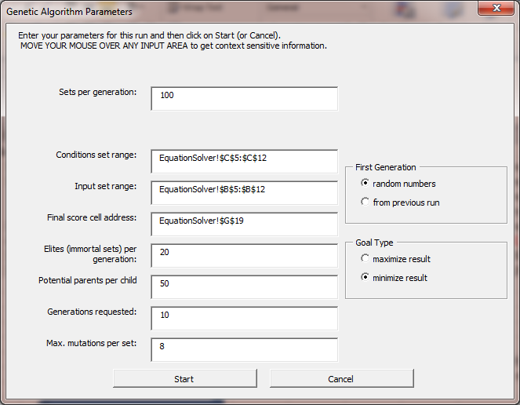
Input Screen for FREE workbook
Specify the sheet and range for your constraint criteria.
Specify the range for your variable values
Enter the location of the final score

Slide 16

Recap – what did we learn?
Genetic algorithms can be useful in many diverse types of situations.
You don’t need to be a math, genetics, or stats wiz or a programmer to understand how to make one.
You can use the free tool to do a lot of learning just with Excel.
This is the tip of the iceberg. Join the Forecasting & Futurism section and tap into a cornucopia of new tools and techniques.

Slide 17






New Tools Require New Skills
3+4=4+3
3-4≠4-3
Find this video on YouTube via search term ChainsawAlton (one word).
Complexity
Sciences

Slide 18
Feedback
Q & A
Ideas for improvement
Genetic Algorithms – What They Are, How to Apply Them to Solve Problems, and How to Create Your Own
David L. Snell, ASA, MAAA, FLMI, CLU, ChFC, ARA, ACS, MCP
technology evangelist, RGA Reinsurance Company

